Slide 1
CineNox
A Movie Ticket Reservation System
Made By:- Ruhan Chattopadhyay & Chitresh Ghoshal
Vivekananda Mission School

Slide 2
AIM OF THE PROJECT:
The aim of the project is to provide a comfortable and user friendly console-based interface to the user
through which he/she can book tickets to a movie from their home.
DESCRIPTION OF THE PROJECT:
The project is based on a movie ticket reservation system that allows the user to select seats as
per their convenience in a real time environment, along with visual layout of a movie theatre and
generating bill for the user and stores the data in files for future reference.
The project is saves the user a lot of time by allowing them to book the tickets right from their home. It also allows the user to book multiple tickets at once.

Slide 3
FEATURES:
Has a new user creation system.
Has a existing user login system.
Stores usernames and passwords in a text file.
Displays available shows and all the timings for the show.
Allows user to input the movie he/she wants to watch along with the specific timings
Displays the layout of the cinema hall seats along with booked seats for the particular show and time.
Has option to book multiple seats at once
Has the option to let the user decide if they want to order food or not.
Shows the bill to the user while also storing the required information in a text file as a log for someone to check.
Has extensive error checking for user login as well as booking.

Slide 4
METHODS USED IN THE CODE:
public static void main(String args[])
void login()
void newuser()
void existingUser()
void displayMenu()
void BillPrint(String path1)
void CreateMatrix()
void onboarding(String path)
void check(String path)
void Print()
void Food()

Slide 5
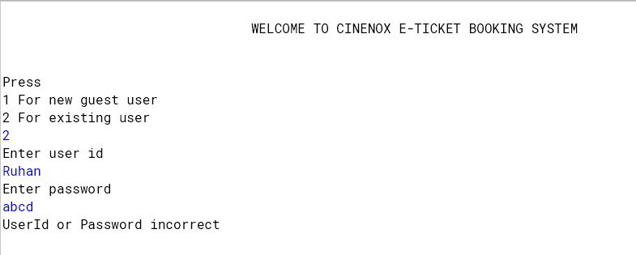
Few Features In Depth
If existing user enters wrong user id and/or wrong password, it will show error message and terminate the program

Slide 6
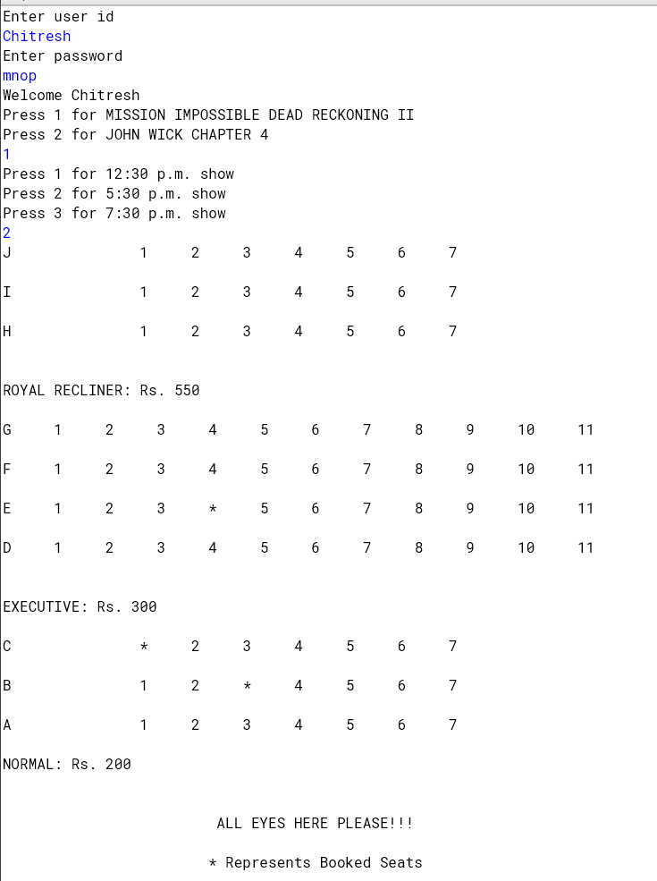
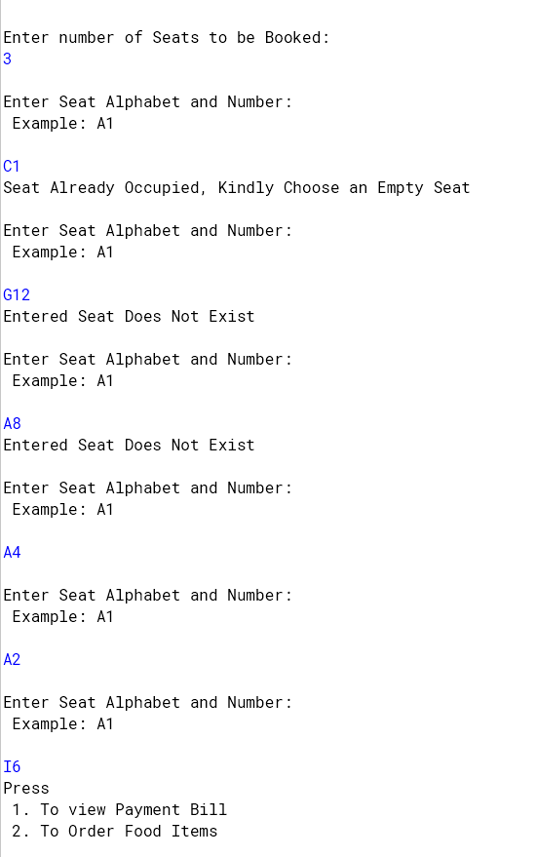
For a specific show and time if some seats are booked before, the seats will be displayed with a “ * ” sign.
The code has error checks for seats which does not exist or is occupied.
For eg. G12,A8 does not exist and C1 is already occupied.

Slide 7
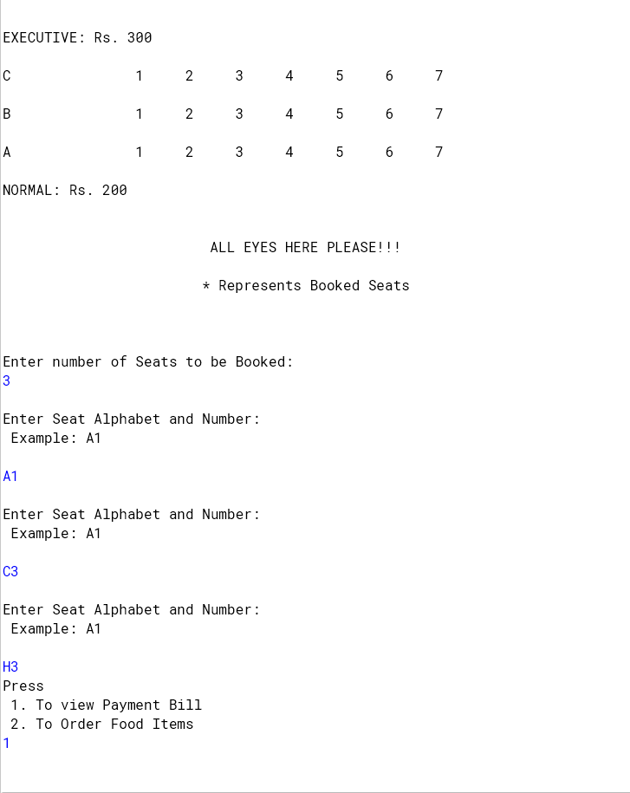
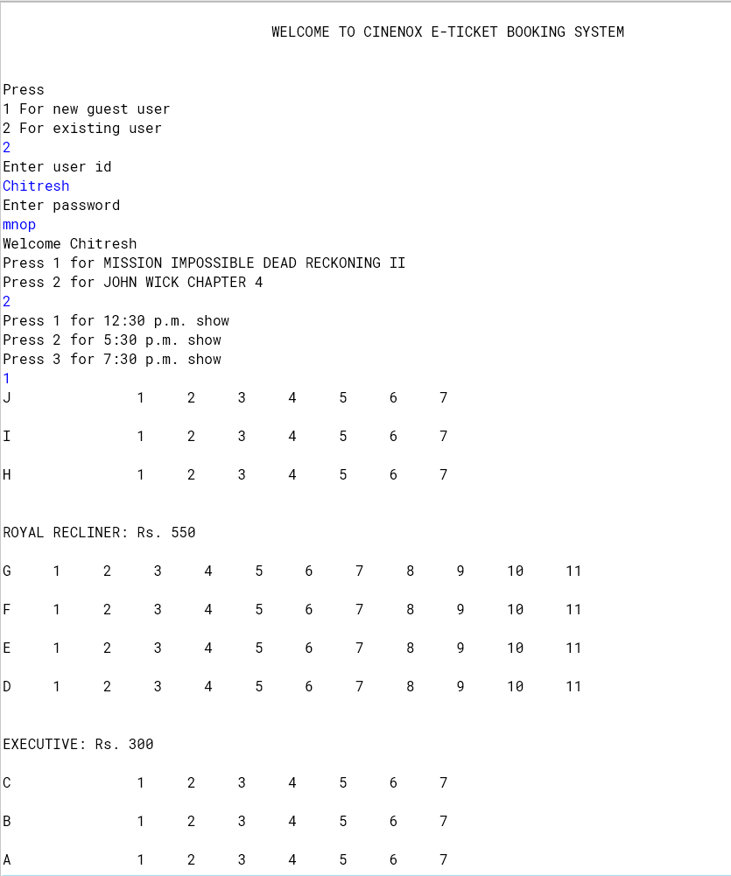
For a movie and timing where no seats are booked, the layout is shown with no “ * ” symbols

Slide 8
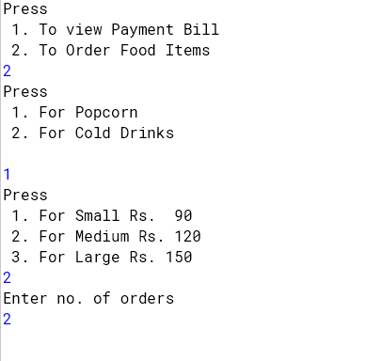
Users can choose to order food items as per their need. The ordered food amount will be reflected in the bill.

Slide 9
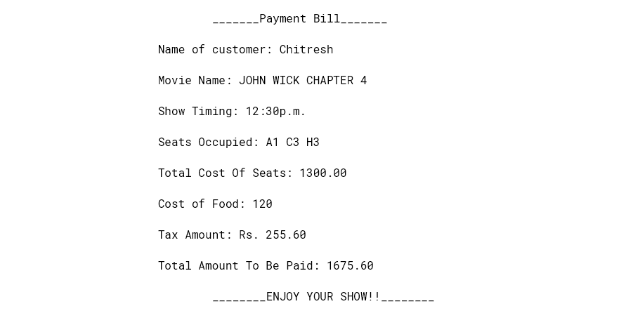
After the user selects the movie, showtime, seats and food (if any), the bill is printed with the following details and the details are also stored in a text file for future reference

Slide 10
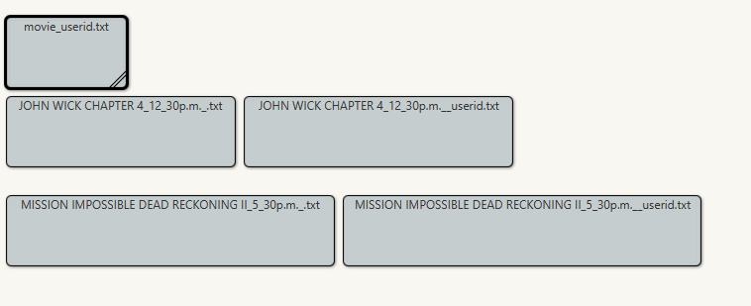
For every combination of movie and timing that the user enters two new files are created automatically if it does not exist already. One of the file i.e without the _userid contains the seat numbers for the booked seats so when the layout for that show and time is printed, it shows the occupied seats correctly regardless of the fact if the program has been closed and opened again
The
<movie name>+<timing>+_userid.txt
stores the information of the users that have booked that show at that time. It stores the name of the user, timing, seats booked, total cost.
If multiple users book the same show at the same time, it stores the data of the next users in the next line. An example of this is shown in the next slide

Slide 11
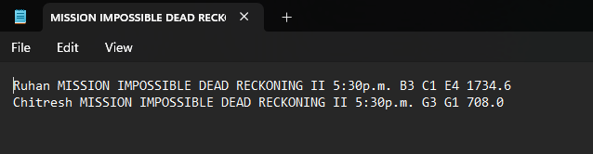
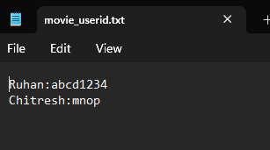
The
<movie name>+<timing>+_userid.txt
stores the information of the users that have booked that show at that time. It stores the name of the user, timing, seats booked, total cost.
If multiple users book the same show at the same time, it stores the data of the next users in the next line. An example of this is shown in this slide.
A booking for Mission impossible at 5:30pm already exists for user Ruhan, refer to Slide 6. Now if user “Chitresh” also books tickets for the same movie at 5:30p.m, his info is also stored in the file in a new line automatically by the program.
The file “movie_userid.txt” is used to store the user id and password so as to enable the login process to work properly. The user id and passwords are separated by a : in the text file. During login, if any user selects exists already, it checks if their entered password is correct and if it’s a new user, it checks if the user already exists before with the same password

Slide 12
FEW OTHER NOTABLE POINTS:
After bill printing, a message is displayed to the user to choose if he/she wants to go back to the first menu and book some more tickets maybe of a different show or maybe with a different login and another option if they want to exit the program, thus giving the user a flexibility of choice.
The code is written in such a way that no file has to be created manually, each and every file is created automatically by the program as and when required.
There are no separate functions for creating the files of different movies. There are two variables “path” and “path1” which control which file to be opened and edited, and those variables are called within the function. Thus eliminating the need for having different functions for different movies and in the end making the code very efficient.

Slide 13
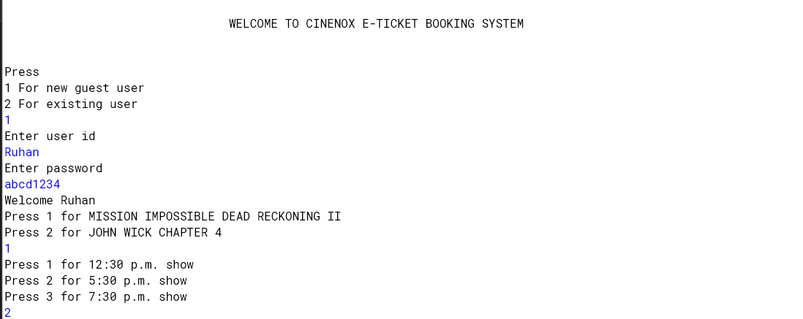
The Code In Action

Slide 14
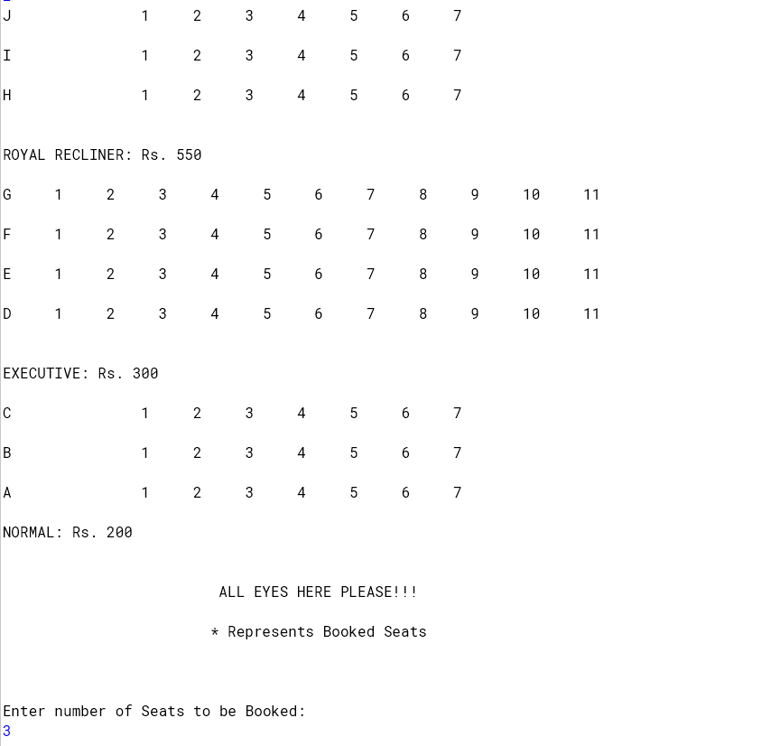
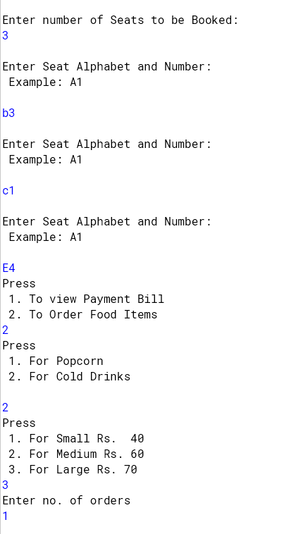

Slide 15
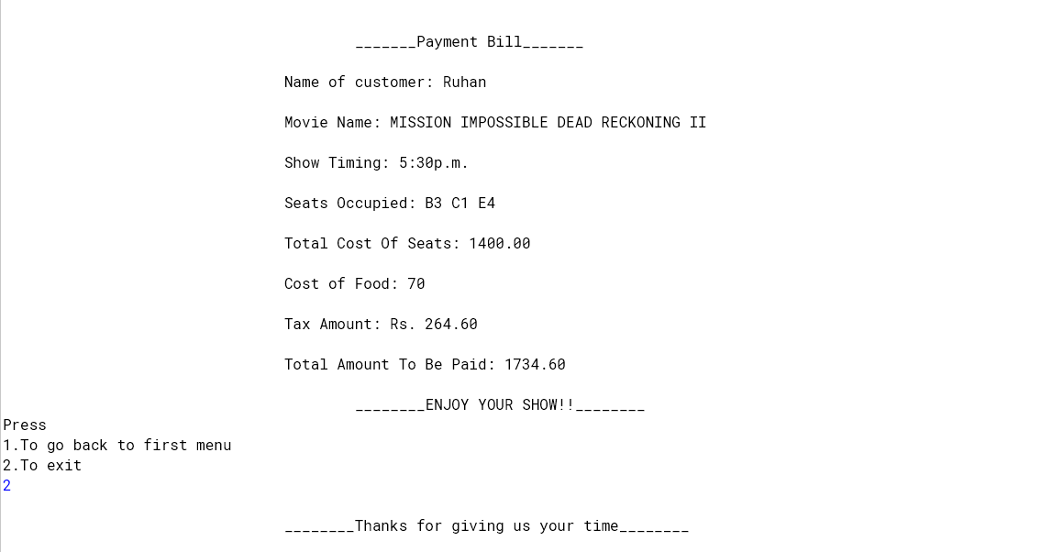
--------------------THE END --------------------

